Slide 1

ALY 3510 AI Foundations:
An Interdisciplinary Approach
Lecture 6:
Natural Language Processing (NLP)
Session/Section: Fall 2026
Time: Monday 5:50-7:10 PM and Virtual
Instructor: Vladimir Shapiro

Slide 2
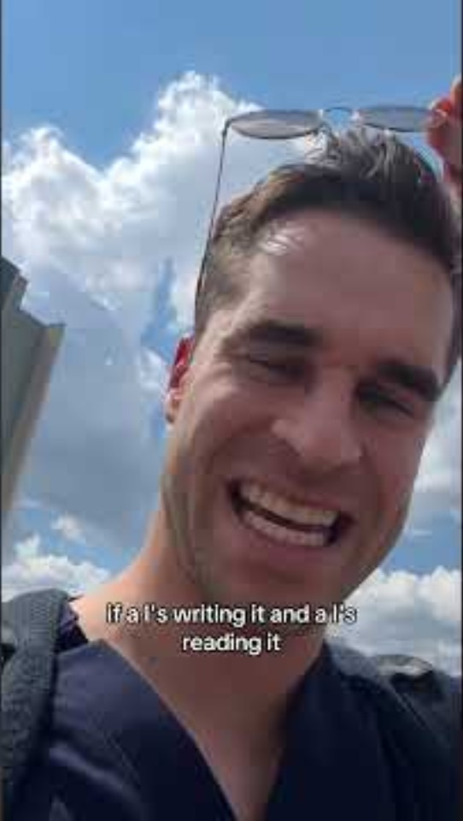
Follow-Up Video (0:40)
“AI Slop”
https://www.youtube.com/shorts/WEBWI8MfwzU

Slide 3
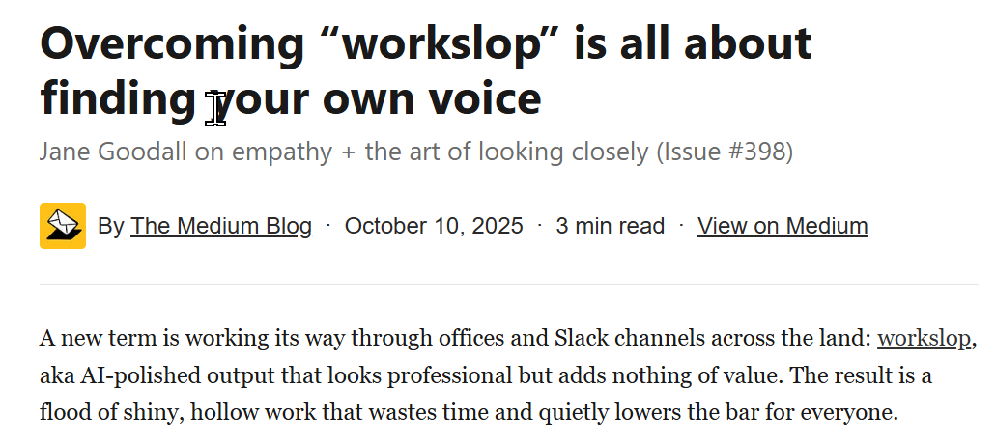
Follow-Up - More about “Workslop”
https://www.youtube.com/shorts/WEBWI8MfwzU

Slide 4

Feedback - Week 5
Reflection Journal
Going well
  AI platforms bring security (several previous students)
  AI platforms provide access to cutting–edge tools, e.g., GenAI (previous students)
  Previous student: SageMaker is really a “workbench + factory” when it comes to machine learning
  Previous student: “how IT teams prevent runaway cloud costs”
  Previous student: “Azure distributes tasks across many machines in data centers around the world. “
  John M., Charles V.: "Amazon SageMaker is … In simple terms, it is an AI workshop"
  Carla: "I think of Azure AI as a toolbox and workspace combined. "
  Kevin: " In simple terms, Azure is a rented set of computing resources plus tools for building AI"

Slide 5
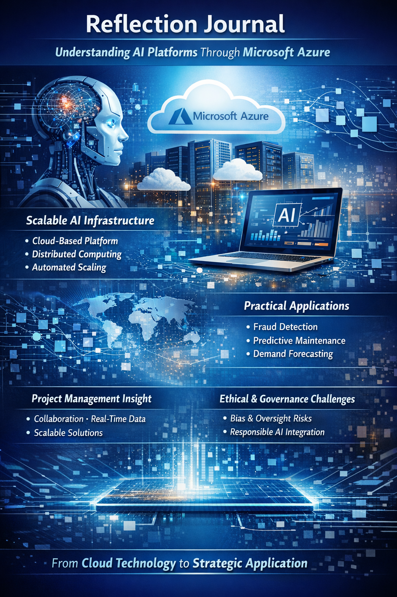
Feedback - Week 5
Reflection Journal
Going well
  Previous student

Slide 6
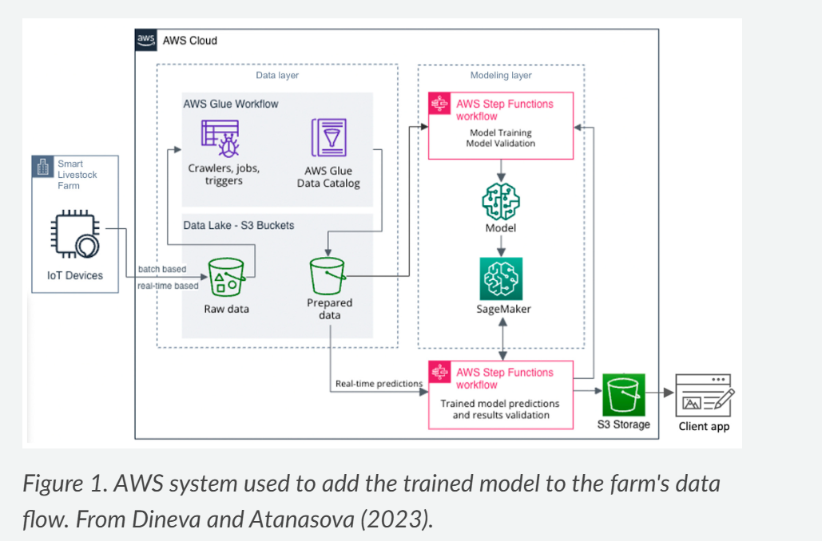
Feedback - Week 5
Reflection Journal
Going well
  Luizza

Slide 7
Feedback - Week 5
Reflection Journal
To improve
  Late or missing submissions.
  Visuals would help support the narrative.
  Researching external sources is beneficial to support your arguments
  Prompts are often being ignored, e.g., "Choose one AI platform and explain its purpose in simple terms"

Slide 8
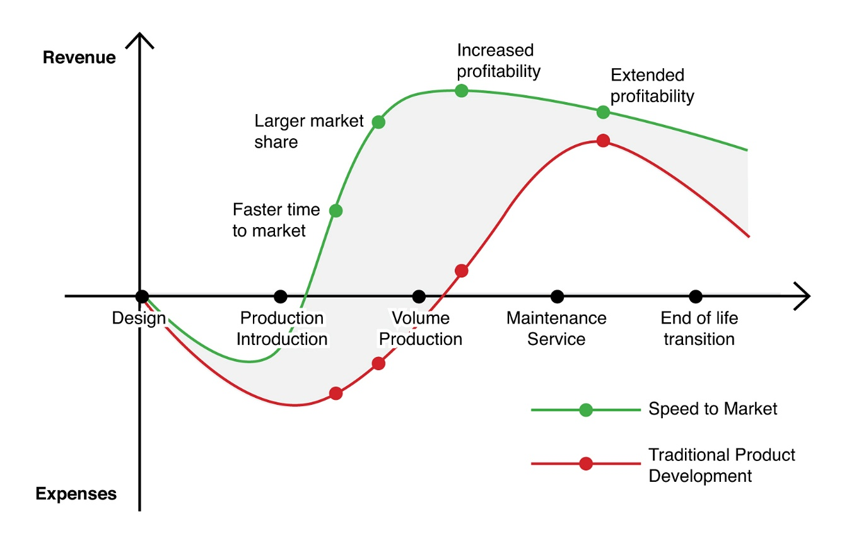
Feedback - Week 5
Reflection Journal
To consider
  It would be nice to say a few words about the history of AI platforms. How and why they came into being…
  How about the “time to market” argument in favor of AI platforms vs. developing solutions “in-house”?
https://share.google/images/BunkVR8srddR0c2vc

Slide 9
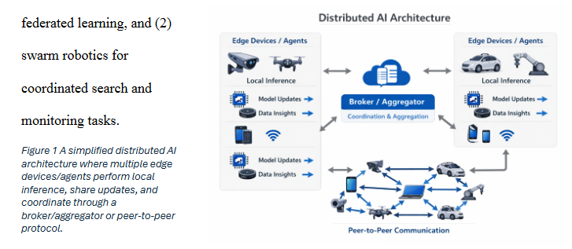
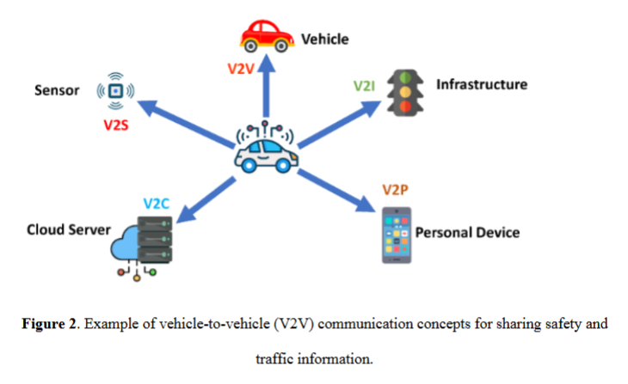
Feedback - Week 5
Assignment
Going well:
  Easy subject?
  Useful visuals (Chelsea, Bohan, Zack) ->
  Good first-hand observation in healthcare - wearable sensors (previous student)
  Faster computation may be critical for real-time
  Bohan: “This video links this idea to real-world applications such as autonomous vehicle networks, smart grids, federated learning, edge AI, and blockchain-based AI “

Slide 10
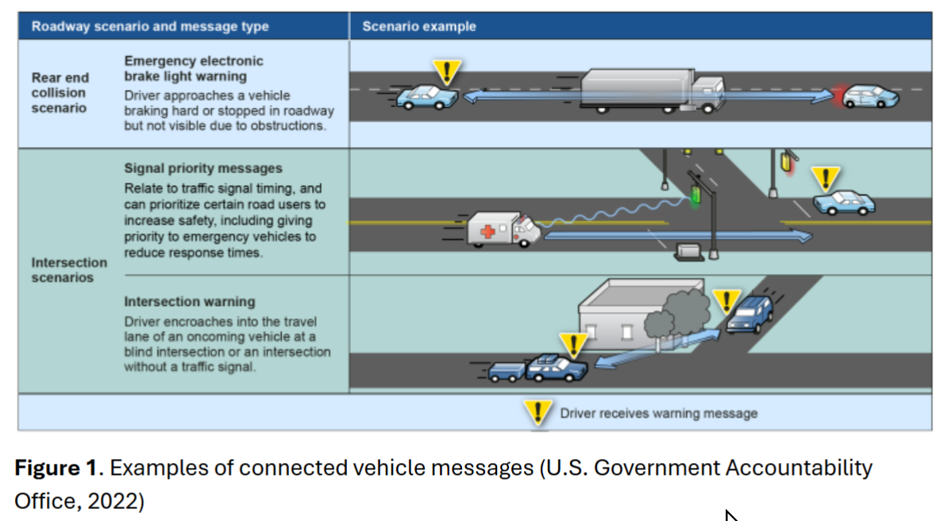
Feedback - Week 5
Assignment
Going well:
  Federated learning (Chris, Zack, Odette, others)
  Heterogeneous systems in Smart Home (Nnamdi)
  V2V (vehicle-to-vehicle) - avert 80% crashes; platooning (previous student)

Slide 11

Feedback - Week 5
Assignment
To improve – formal matters
  Missing submissions!
  “Include visuals whenever appropriate” – how about that?
  It would be nice to summarize the video before developing enumerated tasks

Slide 12
“Touchpoint” meetings with online students
Scope:
  Understand personal situation
  Your feedback on the course content/pace/difficulty, etc.
  Voluntary – email me if you would like to meet

Slide 13
Miscellaneous
Team project
On-ground section - none
Online section - none
Due: Friday 2/27th, EOD

Slide 14
Miscellaneous
Midterm next week
On-ground – on paper
Online section – ProctorU handled

Slide 15
Topics Covered
Course Tracker
Week # | Topic
1 | Overview of AI, history, definitions, and key concepts
2 | Knowledge Representation and Reasoning
3 | Introduction to Machine Learning
4 | Neural Networks & Deep Learning
5 | Distributed AI & AI Platforms
6 | Natural Language Processing (NLP)
7 | Computer Vision
8 | Robotics & Embodied AI
9 | AI & Creativity
10 | Applications of AI – Healthcare, Finance, Education, Retail, Marketing, Entertainment
11 | Applications of AI – Biomedical, Agriculture, Transportation, Mining, Manufacturing, Energy
12 | AI and Society, Bias & Fairness in AI
13 | The Future of AI
15 | No Lecture - Final Project Report & Presentation are Due

